Slide 1


Hii, Iam Siddhika
Welcome to Power BI Series
Part -5

Slide 2

Today Content
Hey come with me let’s go.
Continuation of
CONNECTING & SHAPING DATA
Power Query
Understanding more about Transform tab , Add Column tab. Data Tools
Text Tools Numerical Tools Date & Time Tools

Slide 3

Difference between Transform tab and Add column Tab
Power Query
Think what you need to do whether add or transform column?
Transform tab Used to modify the existing data within columns.
Add column Tab Used to introduce entirely new columns
Remember : You can access many tools from both the Transform and Add Column menus - the difference is whether you want to ADD a new column or MODIFY an existing one,
you need to think before.

Slide 4
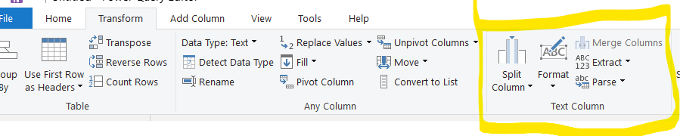

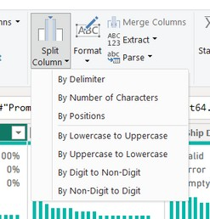
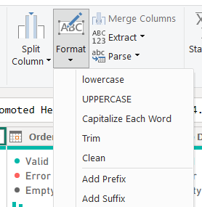

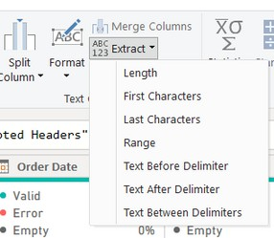
TEXT TOOLS
Have you tried all these?
Split a text column based on a specific delimiter, number of
characters, or other attributes
Format a text column to upper, lower or proper case, or add a prefix or suffix.
Use “Trim” to eliminate leading & trailing spaces, or “Clean” to remove non-
printable characters
Extract characters from text based on fixed lengths, first/last characters, ranges or delimiters

Slide 5
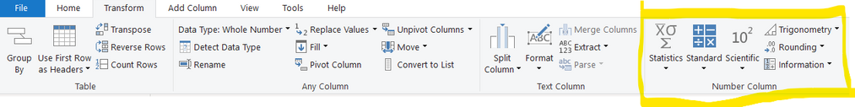
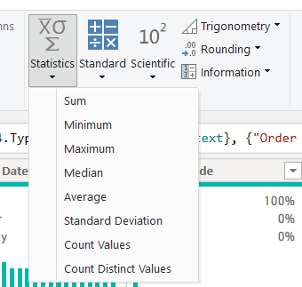
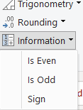


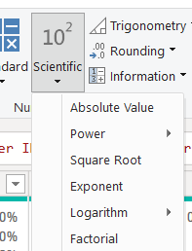

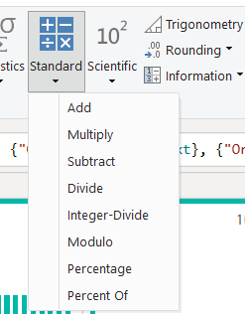
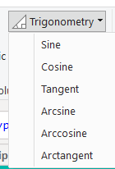
NUMERICAL TOOLS
Statistics functions allow you to evaluate
basic stats for a selected column (sum,
min/max, average, count, count distinct, etc.)
just look at these once
Information tools allow you to define binary flags (1/0 or TRUE/FALSE) to mark rows as even, odd, positive or negative
Standard, Scientific and Trigonometry tools allow you to apply standard operations (addition, multiplication, division, etc.) or
more advanced calculations (power, logarithm, sine, tangent,
etc.) to each value in a column

Slide 6
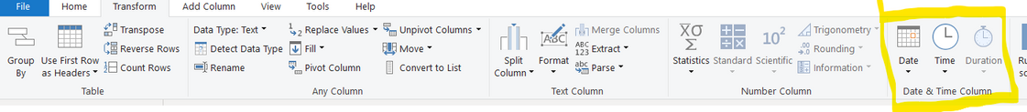
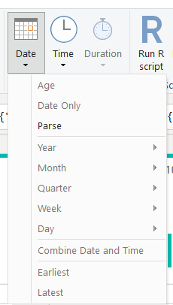

DATE & TIME TOOLS
Date & Time tools are relatively straight- forward, and include the following options:
Age: Difference between the current date and the date in each row
Date Only: Removes the time component from a date/time field
Year/Month/Quarter/Week/Day: Extracts individual components from a date field (time specific options include Hour, Minute, Second,
etc.)
Earliest/Latest: Evaluates the earliest or latest date from a column as a single value (can only be accessed from the “Transform” menu)
Try all these
Remember : You will almost always want to perform these operations from the “Add Column” menu to build out new fields, rather than transforming an individual date/time column

Slide 7

Thank you for joining me today to learn about Part -5 of Power BI!
Remember, with tools like Transform and Add Column, you can shape your data to unlock valuable insights
Stay tuned for more insights and tips on Power BI in our next Series.
Follow
Siddhika Shah

